Slide 1
Numerical Modeling of a Student Developed Self-Pressurizing Liquid Bipropellant Rocket Engine
Jack Slayden, Austin Morse, Sean Rabbitte, Zachary Moore,
Jeffery Reeves, Michael Johns, and Elias Perez
The University of Alabama in Huntsville
AIAA Region II Student Conference, 3/27/2020 - 3/28/2023
Copyright © by Jack Slayden Published by the American Institute of Aeronautics and Astronautics, Inc., with permission.

Slide 2
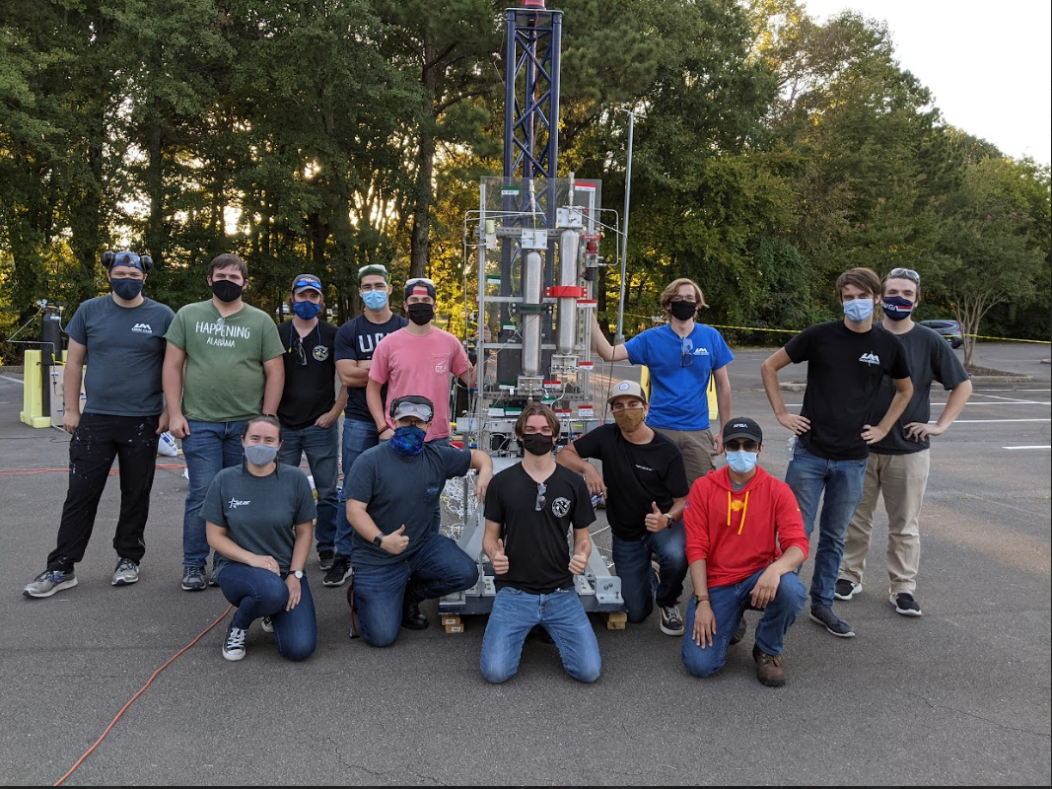
Tartarus Project
The UAH Space Hardware Club
~200 members, 13 projects, 4 programs
Tartarus
Liquid rocketry research and development
Began in August 2017
Propulsion, Fluids, and Controls Subteams
Notes:
Jack:
-Team behind our paper is named Tartarus
-Tartarus is the bipropellant rocketry team of the University of Alabama in Huntsville’s Space Hardware Club
-Goal of eventually producing a flight-ready vehicle for SAC
-Currently focused on ground testing and development, so lots of GSE, instrumentation, fluids, and test engineering
-Today we’re going to be going over some of the simulation and programming work produced by the project over the past year for the purposes of static fire testing

Slide 3
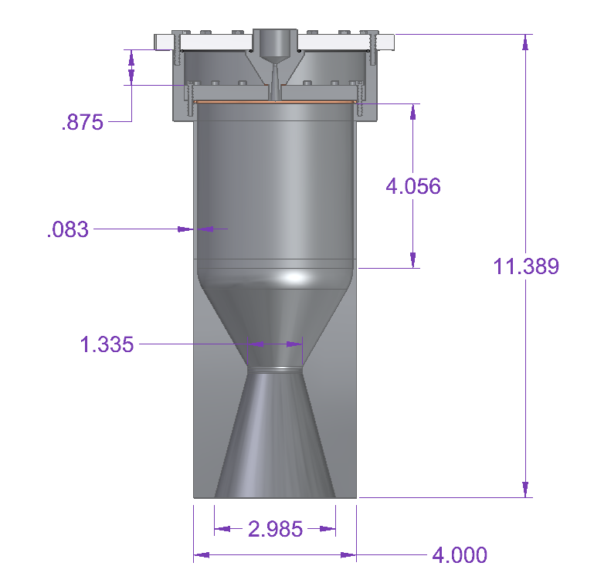
Workhorse Engine
Developed & manufactured in 2019
N2O & C2H6 selected for self-pressurization
Primary cooling method is film cooling
Built solely to validate testing hardware & procedures and design values
“The Workhorse”
Notes:
Jack:
But first, let’s look at the hardware we have to work with.
-Tartarus is planning to conduct its static fire testing on a 600 lbf, self-pressurizing liquid rocket engine
-The current iteration of the rocket engine is one purpose-built for ground testing.
-“the workhorse” – it’s bulkier, less efficient, but more conservatively designed, simpler to manufacture, and easier to integrate instruments.
-30% film cooling, single-element ox injection, and significant extra structural bulk around the converging-diverging section of the nozzle.
-Engine itself was manufactured and ready for testing in late 2019.
-Design values for the engine itself were obtained through the traditional design methods – select a pressure, select an O/F ratio, then design and dimension the injector and nozzle through traditional hand-calculations.

Slide 4
Demand for Simulation Software
Needs of the team:
Simulate static fire system behavior
Account for effect of variable initial conditions
Create a simulation capability to drive future designs
Notable constraints included:
Easy-to-reproduce, accessible
Minimal/no licensing costs
Two-phase propellant support
Notes:
Jack:
-However, the supporting calculations behind the engine design made some simplifying assumptions
-Propellant temperature and vapor pressure was assumed to be fixed, two-phase injection dynamics were simplified, combustion analysis was simplified...
-Need to simulate design against variables like prop temp, ullage volume…
-Need combined time-dependent system simulation
-Want to drive future designs with simulation as well
-However, we want our work to be accessible & repeatable
-Minimal licensing constraints, costs
-Also need two-phase flow support, not found on many existing softwares

Slide 5

Simulation Software
Simulation scripts developed in MATLAB
System design & specs driving inputs
Open-source plugins used for accessibility
Cantera for CEA
CoolProp for equations of state and chemical properties
Notes:
Jack:
The resulting software to meet this need took the form of a MATLAB script.
-Plenty of stock data handling functions
-Every student at UAH is given a student MATLAB license to it’s easily accessible to both Tartarus and most engineering students.
-Keeping with the theme of open-source accessibility, open-source plugins CoolProp and Cantera were employed for thermo tables and chemical equilibrium analysis respectively.
-Scripts developed take design and dimensions as inputs
-Describe the system to MATLAB and MATLAB spits out simulated behavior.

Slide 6
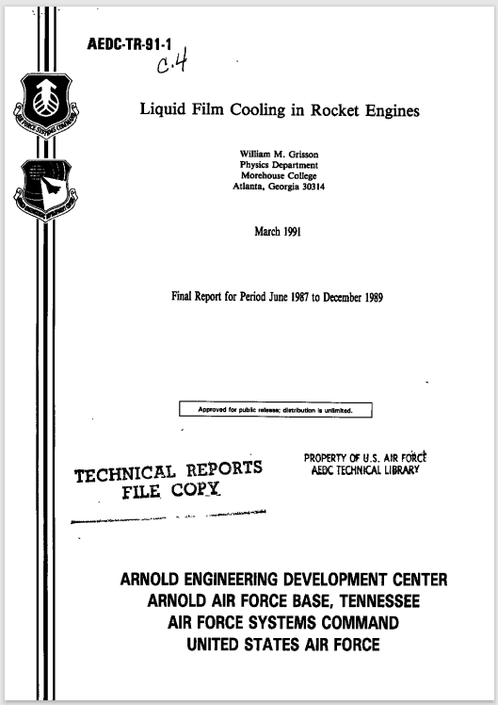
Modeling Methods
Analytical methods compiled from existing research
Novel numerical methods developed for system modeling
Notes:
Jack:
-The actual math involved draws largely on existing, researched, tested, and published modeling methods.
-Actual governing fluid flow equations were largely drawn on published methods, especially film cooling effectiveness and two-phase injection.
-However, combining these methods into a full-system simulation involved development of novel numerical methods and approaches to converging known governing equations. We’ll go into a little more detail over the next few slides on exactly what capabilities we programmed into our simulation.

Slide 7
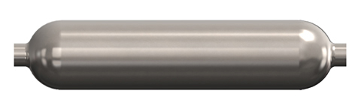
Two-Phase Propellant Flow
Model accounts for two-phase single-node equilibrium conditions within propellant tanks
Numerical integration of transient propellant enthalpy and density
Two-phase propellant injection is resolved using Dyer model
Correction factor applied to linear combination of SPI and NHNE models
Static Fire Test Stand Prop. Tanks
Notes:
Jack:
-Both injector flow and ullage conditions significantly affected by two-phase dynamics.
-Methods were collected to account for two-phase dynamics in both the tanks and at the injector
-Two-phase injection was simple enough, as it could be reduced to one equation proposed by Dyer.
-Without going too much into detail, self-pressurizing dynamics required numerical integration of system of enthalpy-conservation differential equations from Kardas
-Support multiple pressurization methods: isobaric, supercharge, self-press...

Slide 8
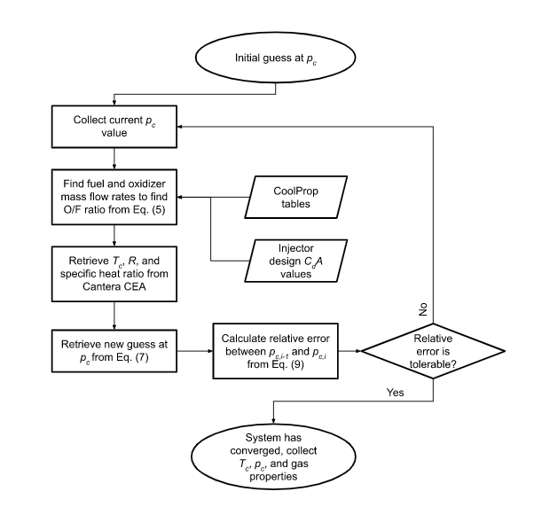
Chamber Modeling
Novel, iterative method employed for quasi-1D chamber conditions
Similar principle to Gauss-Seidel method: converges mass flow equations
Numerically converges two-phase injector mass flow, chamber pressure & temperature
Flowchart of Chamber Parameter Calculation Process
Notes:
Jack:
-Once we’ve got our ullage conditions and injector mass flow rates callable as functions, use it to drive an iterative numerical method
-Similar in principle to (but not quite) the Gauss-Seidel method, converge mass flow rate equations
-Feed injector flow rates into Cantera to get lumped parameters like stagnation temperature and specific heat ratio.
-Converge mass flow rates through the injector and nozzle until chamber pressure reaches equilibrium
-Back out rocket performance using traditional Quasi-1D methods

Slide 9
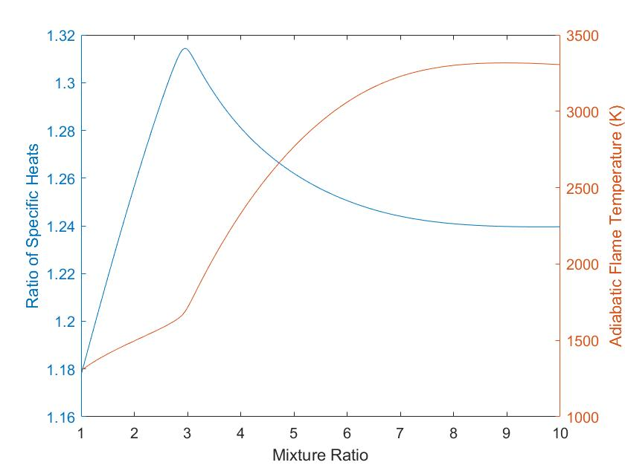
Chemical Equilibrium Analysis
Open-source Cantera software integrated with MATLAB
Automatically calculates essential combustion parameters
Utilizes the GRI-Mech 3.0 reaction mechanism developed by Berkeley
Combustion Parameter Curves of Nitrous Oxide/Ethane at 500 psi
Notes:
Austin:
Accurate modeling (adiabatic flame temp+ratio of specific heats) requires dozens-hundreds of balanced equilibria
Use Cantera for its open-source availability (anyone can use), MATLAB integration with script, and multiple reaction mechanism
Current model used is GRI-Mech 3.0 by Berkeley for Methane combustion, 325 reaction mechanisms/53 species, optimized for Methane but supports small hydrocarbons

Slide 10
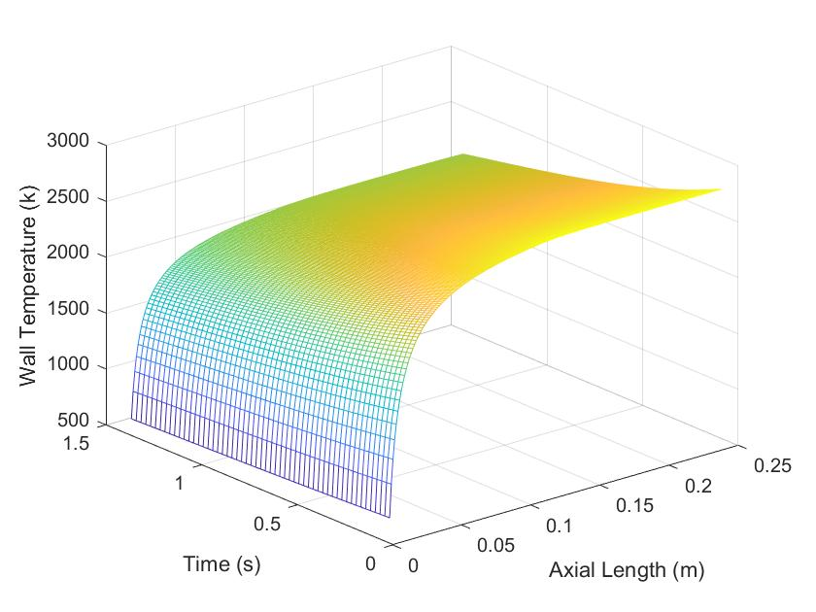
Boundary Layer Cooling
Quasi-One Dimensional thermal analysis
Models cooling in the liquid, two-phase, and gaseous states
Accounts for convective and radiative heat transfer
Engine Wall Temperature During Transient Fire using Gaseous Ethane BLC
Notes:
Austin:
BLC estimated using stepwise numerical integration to calc coolant temp and enthalpy along engine contour
Heat transfer estimated with Stanton number correlation
Models coolants evaporating, gaseous cooling with free stream entrainment
Radiation accounted with empirical relationship, CO2 and H2O radiation with correction
Bartz correlation for wall-side transient transfer

Slide 11
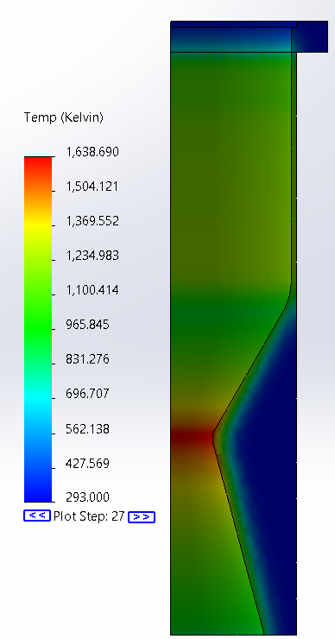
Transient Thermal FEA
Thermal characteristics obtained from BLC analysis
Thermal analysis was done to analyze how the engine could handle the loads applied
Loads created using transient analysis with data provided by MATLAB sim
Notes:
Austin:
Talk about deriving the transient data from the sim: Values for temperature and convective coefficient were calculated at multiple points from the injector face
Values were applied to the solidworks model in the thermal simulation program, applying a time curve and temperature curve to model the transient behavior
The model was simplified to a ¼ slice of the engine with a curvature-based mesh, with an adiabatic surface applied to the sectioned surfaces to model the symmetry.
The results were shown in kelvin here
(avoid talking about melting temperature or what those results mean idk)

Slide 12
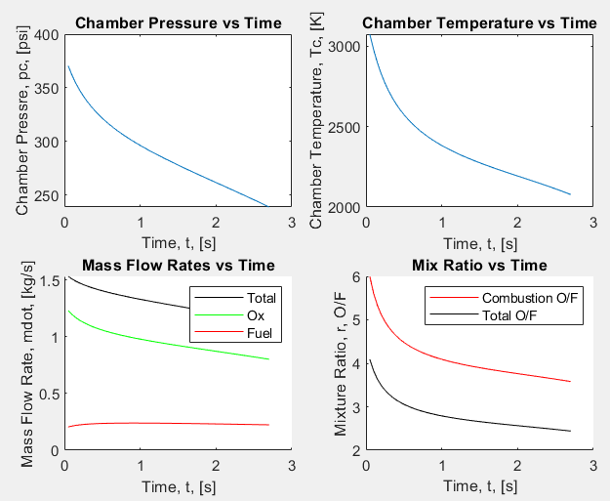
Simulation Capabilities & Applications
Now, the team is able to:
Simulate rocket performance in static fire tests for model & design validation
Predict nozzle thermal loads after application of film cooling
Drive future engine designs: different propellants, nozzle, pressurization, injector…
Sample Simulation Output
Notes:
Austin:
-Using the MATLAB scripts developed, the team is able to produce a wide array of insightful data relevant to the design and performance of the rocket engine throughout firing
-Can predict effect of certain test variables on performance, such as initial prop temperature or ullage volume
-Can also vary input system design values to simulate changes to system configuration, such as pressurization method
-More importantly, after validating simulation, the MATLAB script can be used to drive future designs & iterations

Slide 13
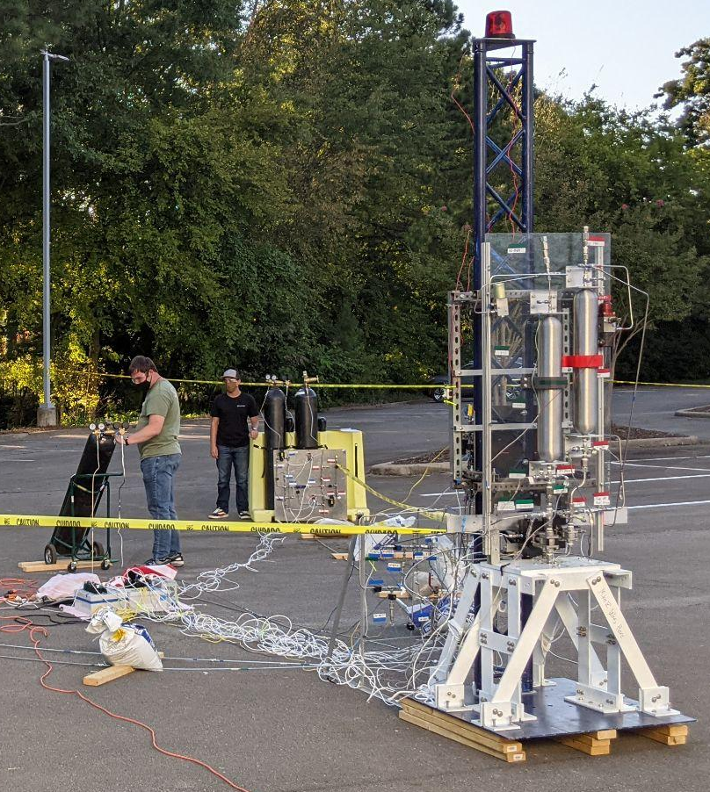
Simulation & Design Validation
Modeling methods must be validated via static fire testing
Evaluate accuracy of modeling methods, assumptions
Empirical correction factors for C2H6+N2O can be developed
Static Fire Test Setup
Notes:
Austin:
Hotfire will provide temp and pressure data, real-world performance data
Empirical corrections applied to model to match hot fire
Boundary layer cooling estimates will be estimated
Empirical corrections will allow better modeling for N2O/C2H6 specifically

Slide 14
Future Work
Future Script Development:
Application of empirical corrections
GUI for simulation inputs in the works
Implement more reaction mechanisms for more propellant options
Future Applications:
New test configurations
Drive future designs
Notes:
Austin:
Empirical corrections from hot fire tests, partic. for N2O/C2H6
GUI to be developed for more user-friendliness
More reaction mechanisms to be ported to Cantera, support more props (Ethanol), allow to switch between for different props.
Model will provide predictions for new test configs, accelerated development
Model will quickly provide performance numbers for new engine configs, support new propellants

Slide 16
Presentation Title
Please note formatting guidelines below.
Landscape orientation
16:9 ratio
Font
Sans serif (e.g. Helvetica, Arial, Tahoma)
Sized 24-40 points
Minimal information—highlight main points
No commercialism/advertising
Can your slides be easily read from 15 meters away?

